Slide 1
Shell Line Commands (Windows, Mac & Linux)
Week 4

Slide 2
Mac and Linux OS Terminals
Change Directory Command: cd
Example: cd “path/to/directory/”
List/Check Directory Command: ls
Example: ls “path/to/directory/”
Open Files Command: open
Example: open “filename”
Copy a file to another Directory Command: cp
Example: cp “filename” “newfilename”
Move a file Command: mv
Example: mv “filename” “path/to/new/file/location”
Create a file Command: touch
Example: touch myfile.txt

Slide 3
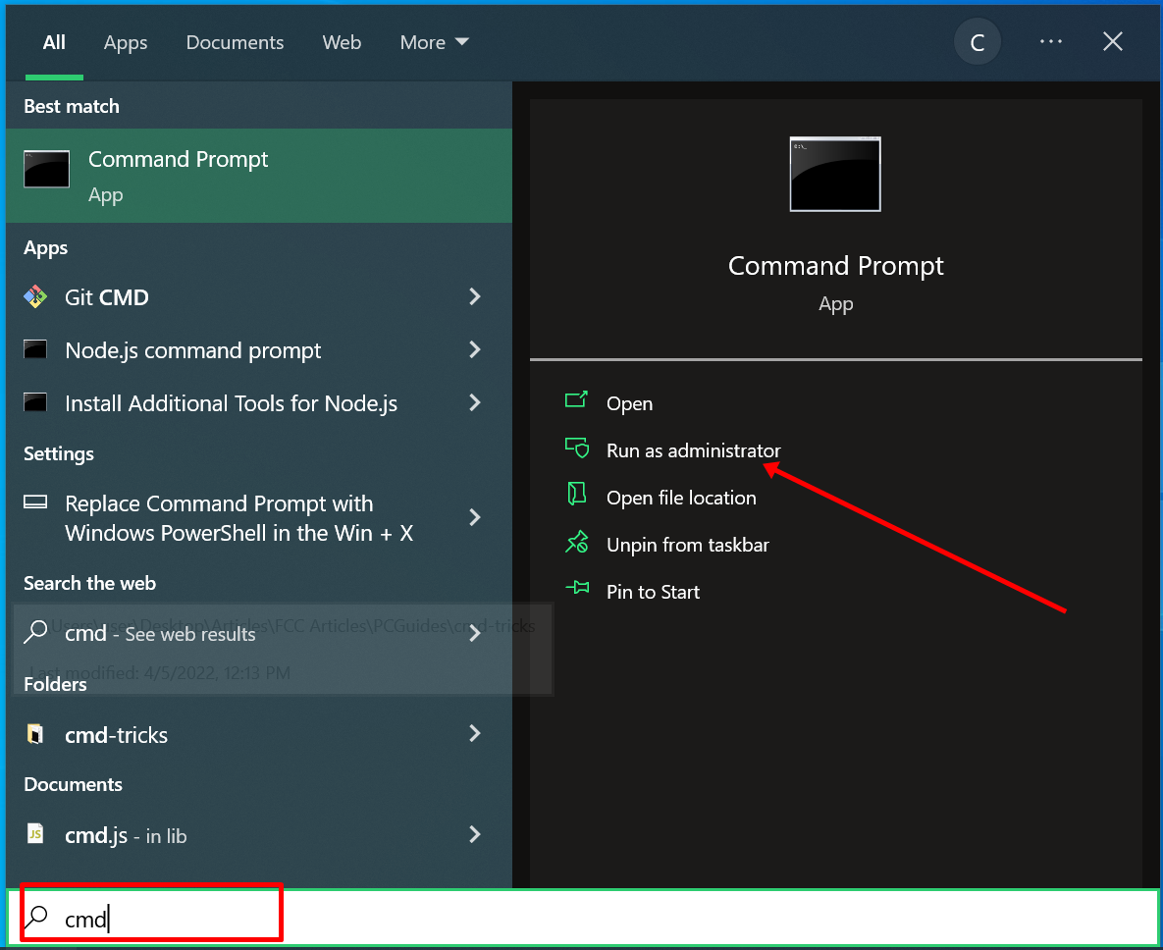
Windows Command Line
The Windows command line is one of the most powerful utilities on a Windows PC. With it, you can interact with the OS directly and do a lot of things not available in the graphical user interface (GUI).

Slide 4
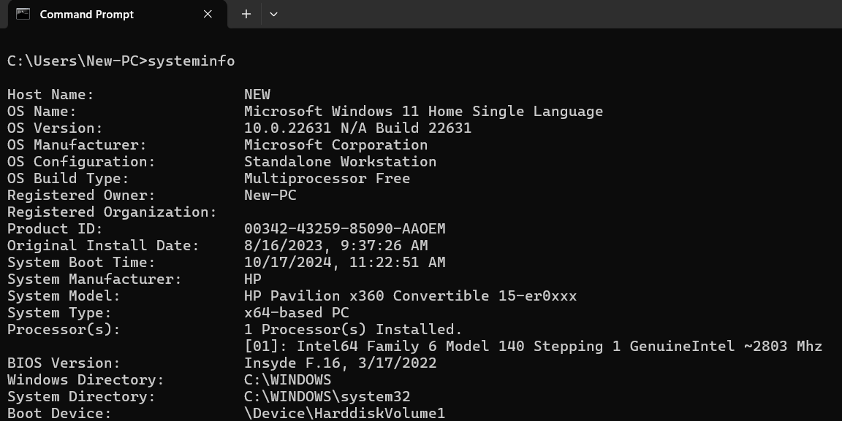
Check System Information
To see more detailed information about your system you won’t see in the GUI, use the command >>systeminfo

Slide 5
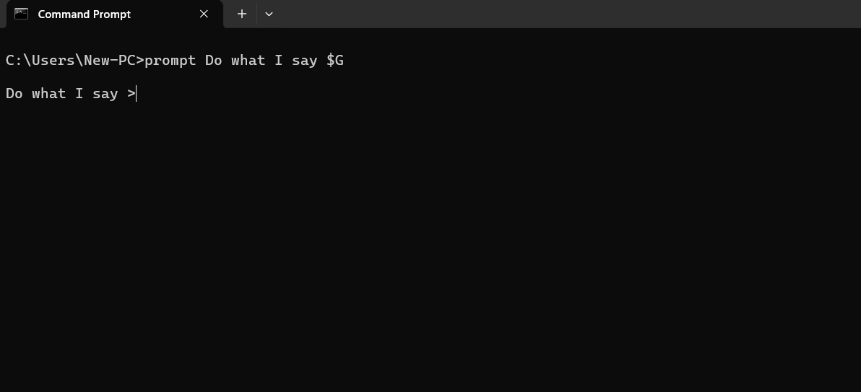
Change Default Text before Entering Commands
You can use the prompt command to change that default text with the syntax prompt prompt_name $G:

Slide 6
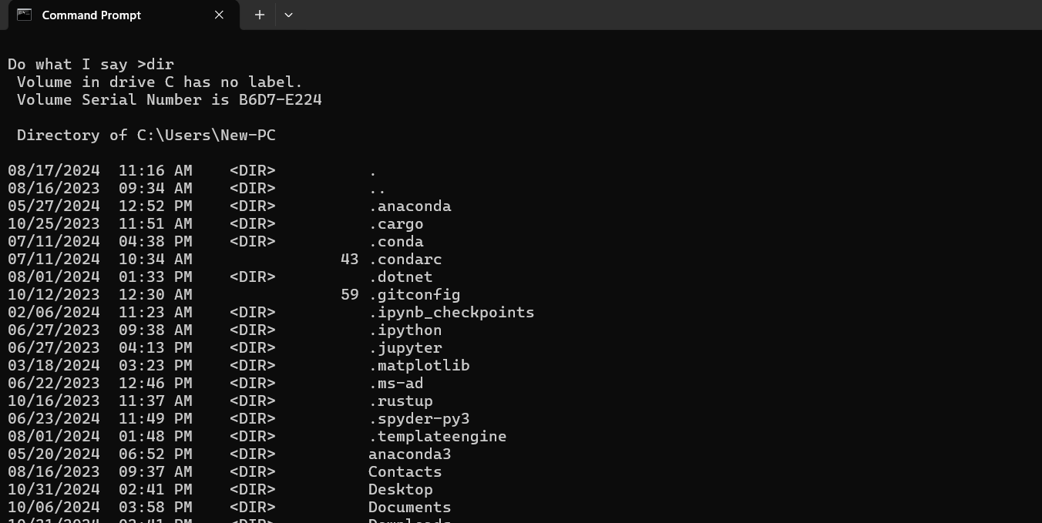
Check Folder/Directory
You can use the dir command to check files in a directory/folder:

Slide 7
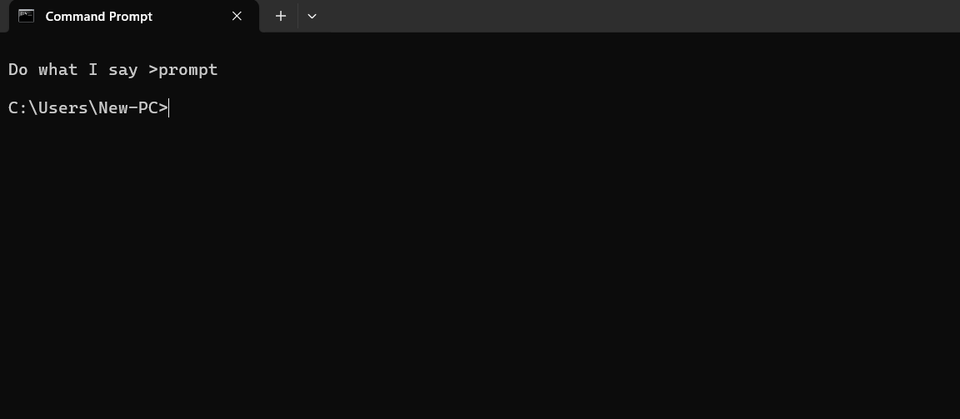
Check Folder/Directory
You can use the prompt command to return to original path:

Slide 8
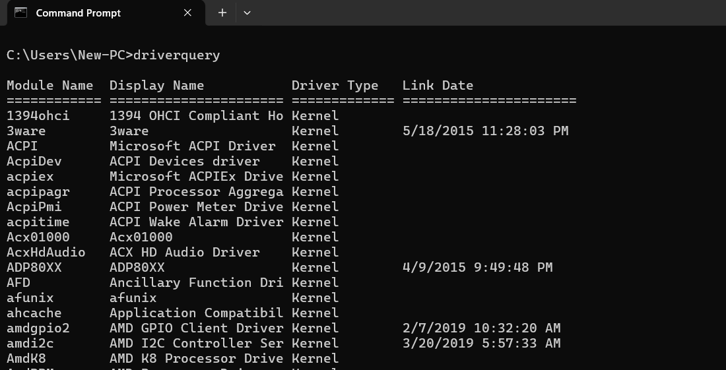
List All Installed Drivers
You can use the driverquery command to check all your installed drivers:

Slide 9
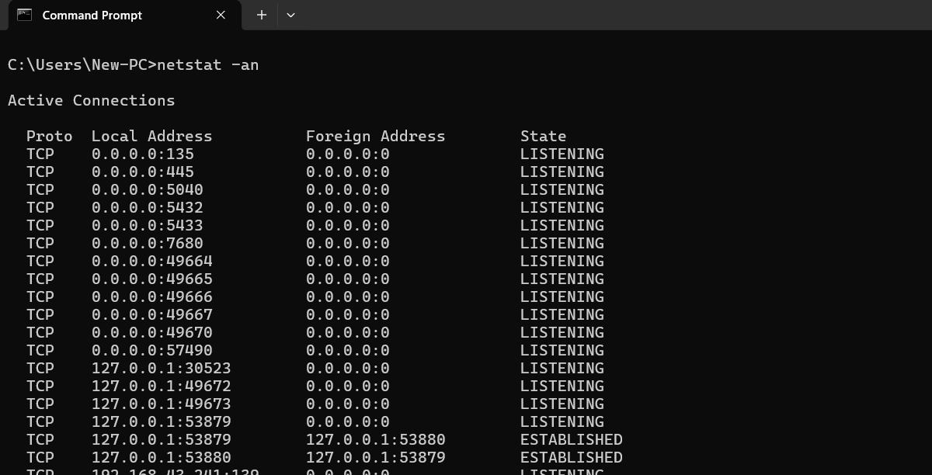
Check Open Ports, IP Addresses & States
You can use the netsat -an command to show all open ports, their addresses and states:

Slide 10
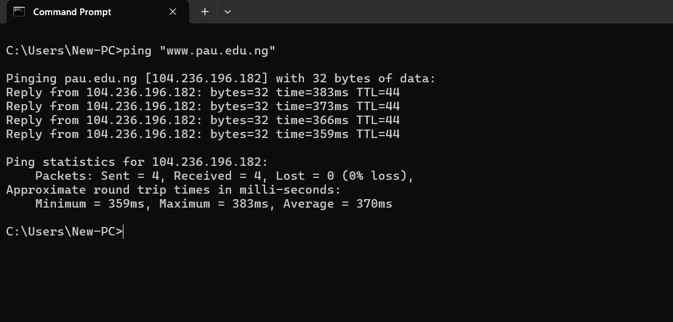
Ping a Website IP Address
You can use the ping command to check any website IP address and state:

Slide 11
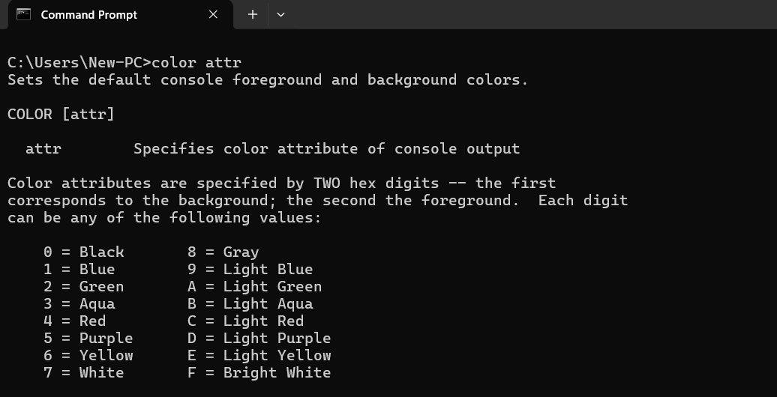
Change Text Color of the Command prompt
Enter color attr command to see the colors you can change to:
Entering color 2 changes the color of the terminal to green

Slide 12
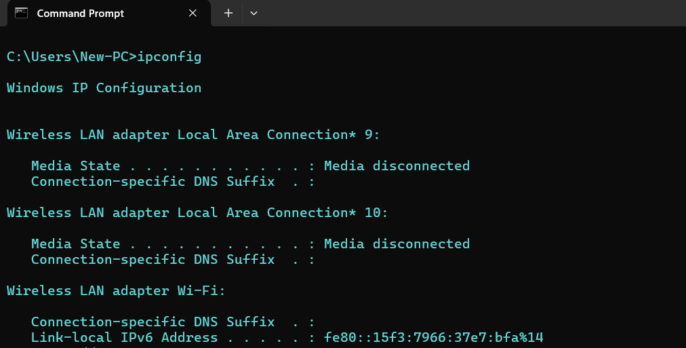
Check PC Configuration & Connections
You can use the ipconfig command to show information about PC IP Address and Connections:

Slide 13
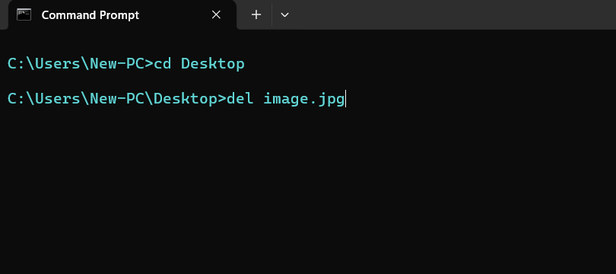
Delete a File
You can use the del command to delete a file:

Slide 14
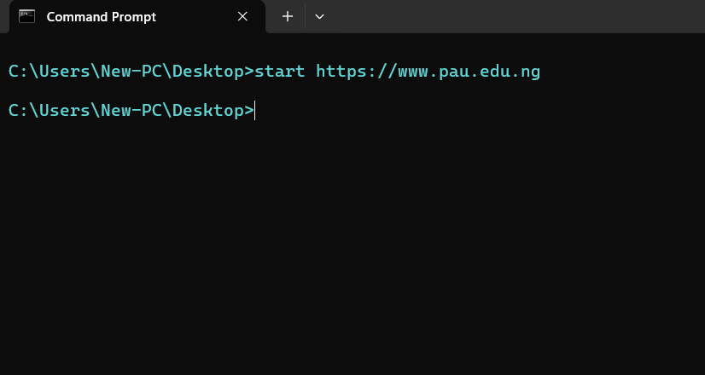

Go to a Website from Command Line
You can use the start command to log on to a Website form command line:

Slide 15
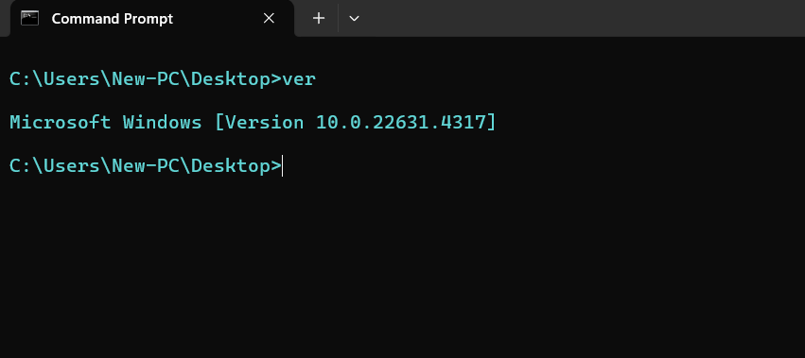
Check the Version of the OS
You can use the ver command to show the version of the Operating System:

Slide 16
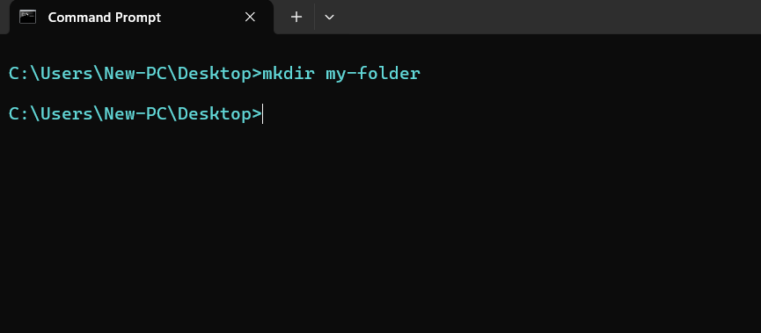
Create a Folder
You can use the mkdir command to create a new folder:

Slide 17

Delete a Folder
You can use the rmdir command to delete a folder:

Slide 18
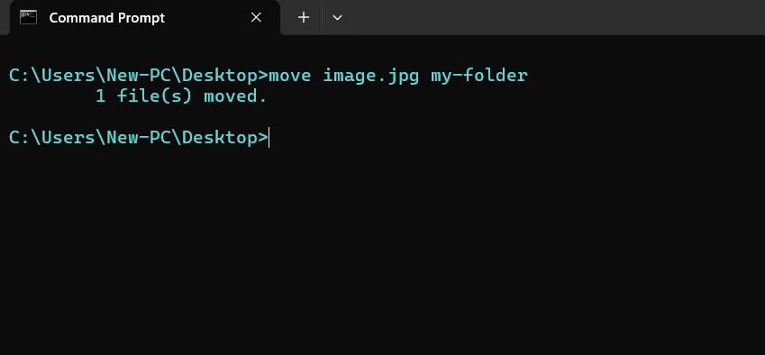
Move a File or Folder
You can use the move command to move a File or Folder to a Specified Folder:

Slide 19

Rename a File
You can use the ren command to rename a file with the syntax
ren filename.ext new-name.ext:

Slide 20
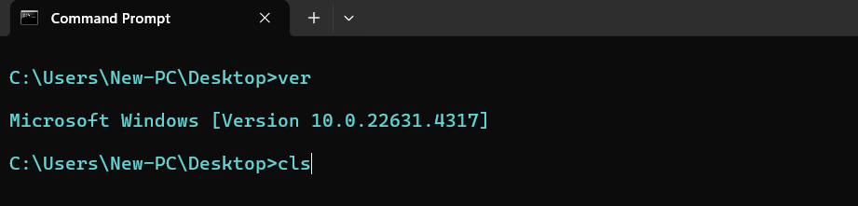
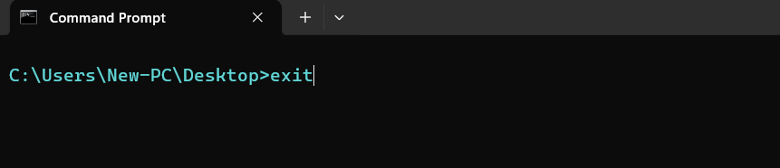
Clear & Exit Command Line
You can use the cls command to clear the command line & exit command to close the command line :

Slide 21
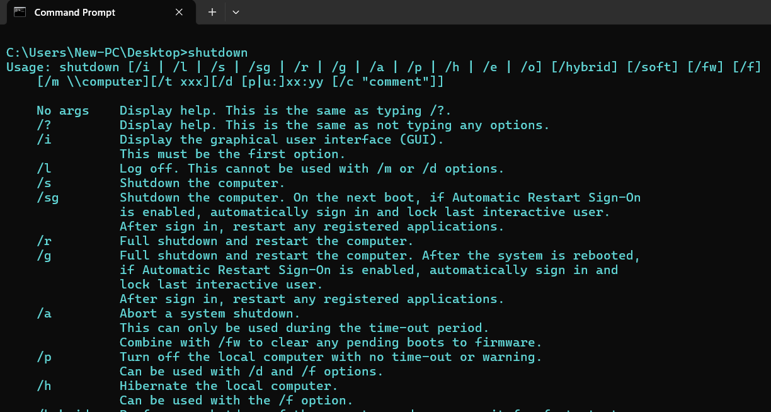
Shutdown, Restart, Hibernate and Sleeps PC
Enter shutdown command to see the extension you can use to perform the action:
E.g. shutdown /r will restart your computer

